Slide 1
Demonstration of Robot- Assisted Welding Process
Topic from Manufacturing Science

Slide 2
What is Welding?
Welding is a joining process, where two parts or piece of metals or alloys or thermoplastics are joined by applying heat, pressure or both.

Slide 3
Requirement for welding process?
The parent material of metal/alloy piece for welding.
Heat source to melt the material.
A filler rod to supply extra material as and when required.
Depending on how the heat is produced to melt the metal piece, Welding process are classified into various types.
Fusion Welding (Done above the melting point temperature of the parent material)
Solid-state Welding/Pressure welding (Done below the melting point temperature of the parent material

Slide 4
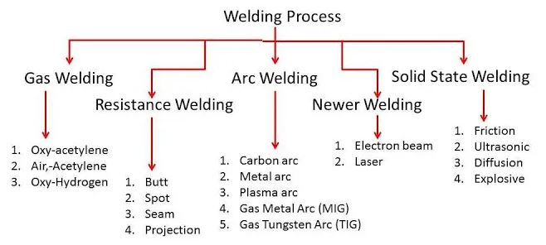
Classification of welding process

Slide 5
Robot assisted welding process
When the welding process is performed with the aid of a semi or fully automatic robot arm, then the process is known as Robot-assisted welding process.
Components of Robotic Welding:
A:- Welding Power Source
J:- Welding Robot
B and C:- Robot Controller and Interface
E:- Wire Feeder
K:- Torch

Slide 6
Advantages of Robot assisted welding
Increased efficiency due to longer working hours and high speed
Better accuracy due to no human errors
Less waste due to precision
Enhanced Safety due to no direct human contact and safety features.
Once installed, robotic welding are cost effective due to less man power requirement and more efficiency.

Slide 7
Disadvantages of Robot Welding over Manual Welding
Very high investment cost for setting up the machinery
Less flexibility due to fixed programs
Not feasible for small projects and applications due to more cost and time to set up and program.

